Slide 1
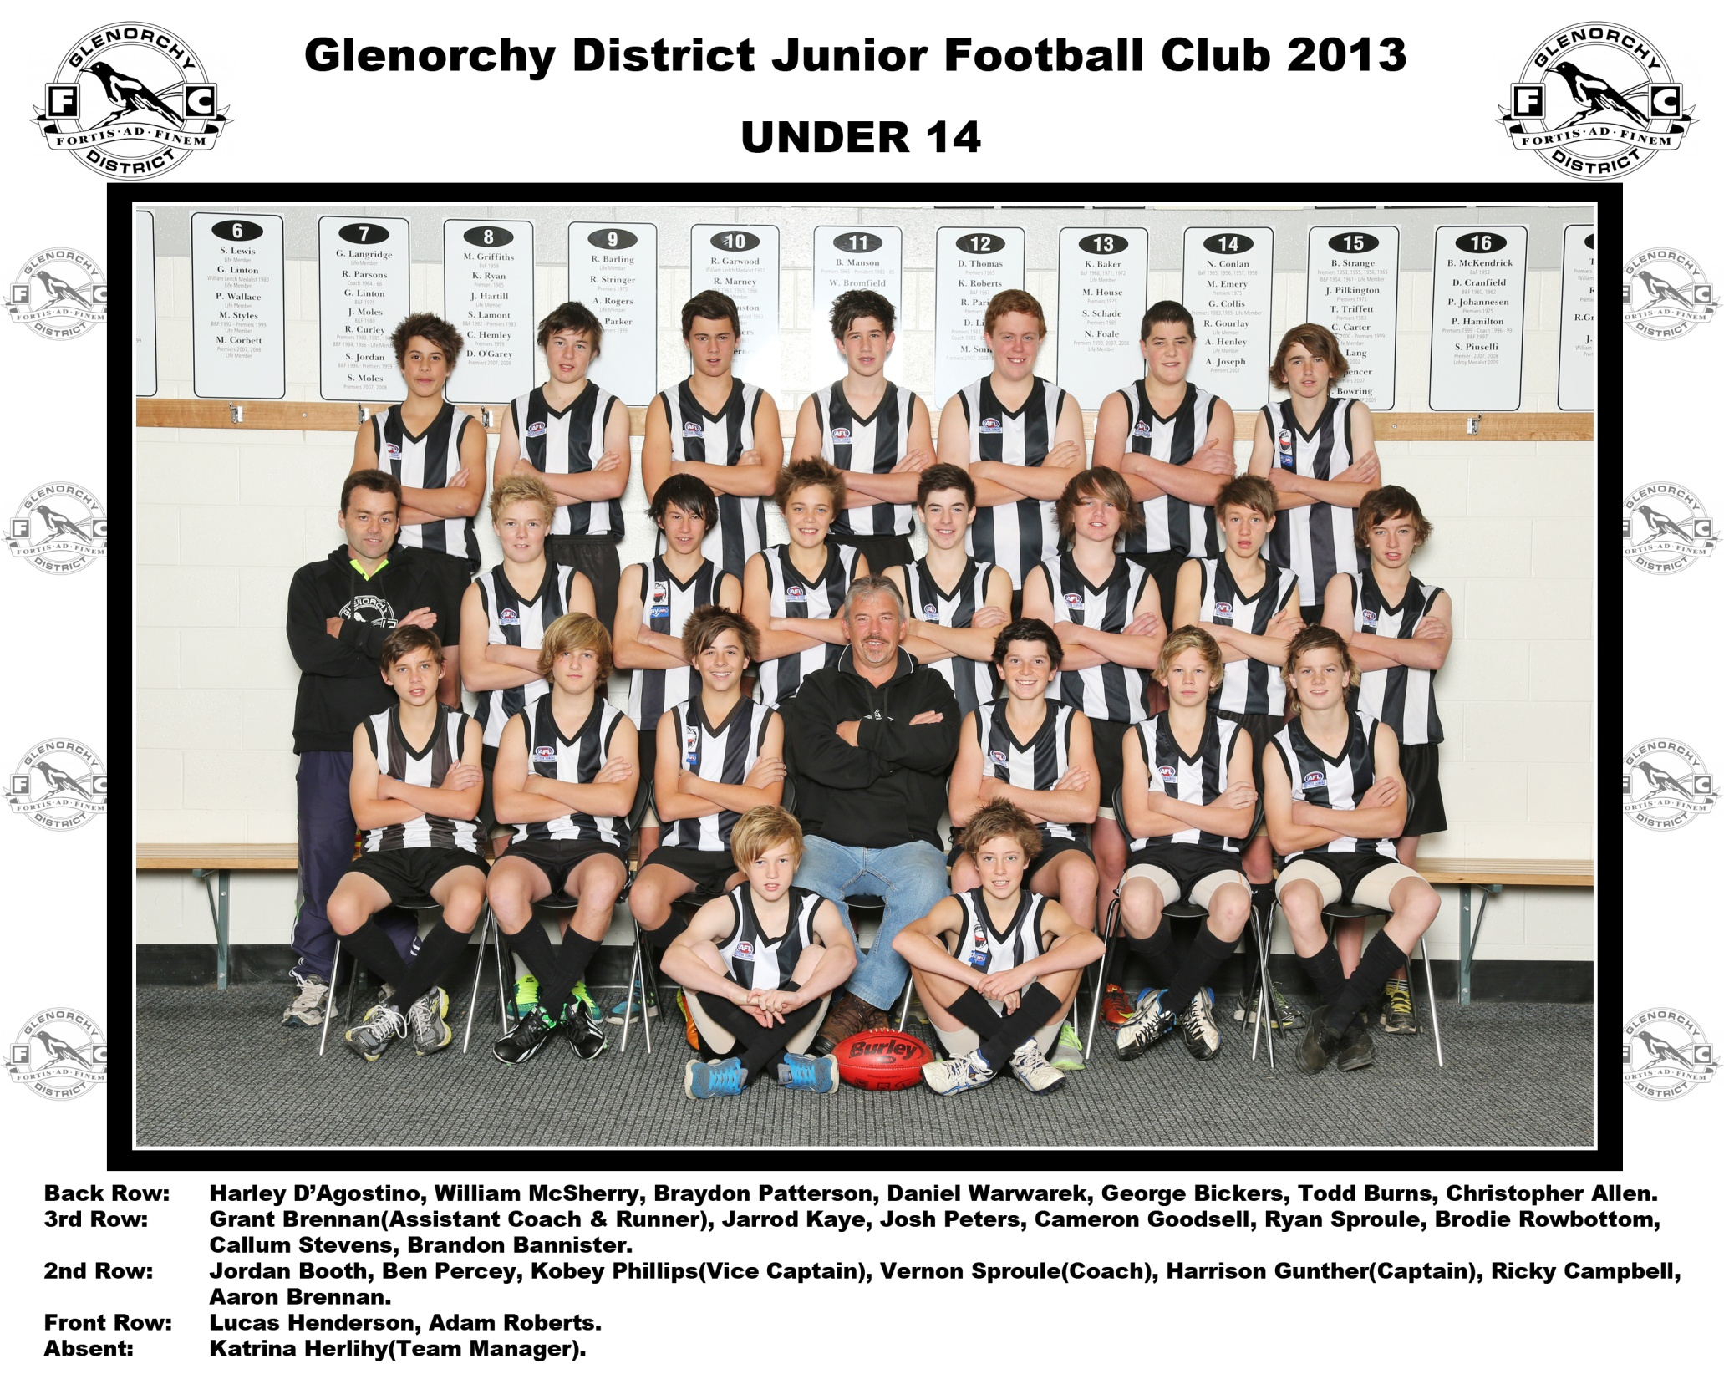

Slide 2

Welcome Title
WELCOME TO THE
2013 Under 14
BEST AND FAIREST COUNT

Slide 3
Introduce Presenter
2013 Under 14
BEST AND FAIREST COUNT
Presenter
Steve Maxwell

Slide 4
Round 1
2013 Under 14
BEST AND FAIREST COUNT
ROUND 1
Glenorchy V Sandy Bay
5
4
3
2
1
Daniel Warwarek
Braydon Patterson
Brodie Rowbottom
Harrison Gunther
Jarrod Kaye

Slide 5
Round 1
2013 Under 14
BEST AND FAIREST COUNT
ROUND 1
Glenorchy V Sandy Bay
5
4
3
2
1
Callum Stevens
Harrison Gunther
Ryan Sproule
Braydon Patterson
Cameron Goodsell

Slide 6
Round 1
2013 Under 14
BEST AND FAIREST COUNT
ROUND 1
Glenorchy V Sandy Bay
5
4
3
2
1
Harrison Gunther
Ryan Sproule
Cameron Goodsell
Kobey Phillips
Callum Stevens

Slide 7
Round 2
2013 Under 14
BEST AND FAIREST COUNT
ROUND 2
Glenorchy V Kingborough
5
4
3
2
1
Brodie Rowbottom
Ryan Sproule
Callum Stevens
Harrison Gunther
Braydon Patterson

Slide 8
Round 1
2013 Under 14
BEST AND FAIREST COUNT
ROUND 2
Glenorchy V Kingborough
5
4
3
2
1
Ryan Sproule
Brodie Rowbottom
Harrison Gunther
Braydon Patterson
Aaron Brennan

Slide 9
Round 1
2013 Under 14
BEST AND FAIREST COUNT
ROUND 2
Glenorchy V Kingborough
5
4
3
2
1
Cameron Goodsell
Brodie Rowbottom
Jarrod Kaye
Braydon Patterson
Ryan Sproule

Slide 10
Round 1
2013 Under 14
BEST AND FAIREST COUNT
ROUND 3
Glenorchy V Brighton
5
4
3
2
1
Lucas Henderson
Callum Stevens
Aaron Brennan
Harrison Gunther
Ryan Sproule

Slide 11
Round 1
2013 Under 14
BEST AND FAIREST COUNT
ROUND 3
Glenorchy V Brighton
5
4
3
2
1
Brodie Rowbottom
Callum Stevens
Lucas Henderson
Ryan Sproule
Sam Berry

Slide 12
Round 1
2013 Under 14
BEST AND FAIREST COUNT
ROUND 3
Glenorchy V Brighton
5
4
3
2
1
Brodie Rowbottom
Harrison Gunther
Joshua Peters
Aaron Brennan
Daniel Waewarek

Slide 13
Round 1
2013 Under 14
BEST AND FAIREST COUNT
ROUND 4
Glenorchy V Lauderdale
5
4
3
2
1
Daniel Warwarek
Brodie Rowbottom
Cameron Goodsell
Lucas Henderson
Aaron Brennan

Slide 14
Round 1
2013 Under 14
BEST AND FAIREST COUNT
ROUND 4
Glenorchy V Lauderdale
5
4
3
2
1
Braydon Patterson
Brodie Rowbottom
Ryan Sproule
Harrison Gunther
Cameron Goodsell

Slide 15
Round 1
2013 Under 14
BEST AND FAIREST COUNT
ROUND 4
Glenorchy V Lauderdale
5
4
3
2
1
Ryan Sproule
Harrison Gunther
Braydon Patterson
Cameron Goodsell
George Bickers

Slide 16
Round 1
2013 Under 14
BEST AND FAIREST COUNT
ROUND 5
Glenorchy V Southern Storm
5
4
3
2
1
Cameron Goodsell
Kobey Phillips
Lucas Henderson
Brodie Rowbottom
Joshua Peters

Slide 17
Round 1
2013 Under 14
BEST AND FAIREST COUNT
ROUND 5
Glenorchy V Southern Storm
5
4
3
2
1
Ryan Sproule
George Bickers
Braydon Patterson
Harrison Gunther
Joshua Peters

Slide 18
Round 1
2013 Under 14
BEST AND FAIREST COUNT
ROUND 5
Glenorchy V Southern Storm
5
4
3
2
1
Braydon Patterson
Ryan Sproule
Brodie Rowbottom
Lucas Henderson
Joshua Peters

Slide 19
Round 1
2013 Under 14
BEST AND FAIREST COUNT
ROUND 6
Glenorchy V Kingborough
5
4
3
2
1
Kobey Phillips
Aaron Brennan
Brodie Rowbottom
Harrison Gunther
Ryan Sproule

Slide 20
Round 1
2013 Under 14
BEST AND FAIREST COUNT
ROUND 6
Glenorchy V Kingborough
5
4
3
2
1
Harrison Gunther
Ryan Sproule
Joshua Peters
Adam Roberts
Adam Oates

Slide 21
Round 1
2013 Under 14
BEST AND FAIREST COUNT
ROUND 6
Glenorchy V Kingborough
5
4
3
2
1
Adam Roberts
Brodie Rowbottom
Adam Oates
Braydon Patterson
Lucas Henderson

Slide 22
Round 1
2013 Under 14
BEST AND FAIREST COUNT
ROUND 7
Glenorchy V Sandy Bay
5
4
3
2
1
Joshua Peters
George Bickers
Harrison Gunther
Daniel Warwarek
Adam Oates

Slide 23
Round 1
2013 Under 14
BEST AND FAIREST COUNT
ROUND 7
Glenorchy V Sandy Bay
5
4
3
2
1
Harrison Gunther
Ryan Sproule
Braydon Patterson
Kobey Phillips
Adam Oates

Slide 24
Round 1
2013 Under 14
BEST AND FAIREST COUNT
ROUND 7
Glenorchy V Sandy Bay
5
4
3
2
1
Aaron Brennan
Lucas Henderson
Brodie Rowbottom
Ricky Campbell
Harley D’agostino

Slide 25
Round 1
2013 UNDER 14
BEST AND FAIREST COUNT
ROUND 8
Cancelled

Slide 26
Leaderboard 3
2013 Under 14
BEST AND FAIREST COUNT
LEADERBOARD
LEADER BOARD
1
Brodie Rowbottom (49)
7
Cameron Stevens (17)
2
Ryan Sproule (46)
8
Aaron Bennan (16)
3
Harrison Gunther (42)
9
Joshua Peters (14)
4
Braydon Patterson (32)
10
Adam Roberts (13)
5
11
Cameron Goodsell (20)
Daniel Wawarek (13)
6
Lucas Henderson (19)
12
George Bickers (9)

Slide 27
Round 1
2013 Under 14
BEST AND FAIREST COUNT
ROUND 9
Glenorchy V Clarence
5
4
3
2
1
George Bickers
Brodie Rowbottom
Daniel Warwarek
Adam Roberts
Harrison Gunther

Slide 28
Round 1
2013 Under 14
BEST AND FAIREST COUNT
ROUND 9
Glenorchy V Clarence
5
4
3
2
1
Brodie Rowbottom
Joshua Peters
Harrison Gunther
Braydon Patterson
Lucas Henderson

Slide 29
Round 1
2013 Under 14
BEST AND FAIREST COUNT
ROUND 9
Glenorchy V Clarence
5
4
3
2
1
Brodie Rowbottom
Kobey Phillips
Braydon Patterson
Daniel Warwarek
Joshua Peters

Slide 30
2013 Under 14
BEST AND FAIREST COUNT
ROUND 10
Glenorchy V North Hobart
5
4
3
2
1
Todd Burns
Lucas Henderson
Brodie Rowbottom
Kobey Phillips
Braydon Patterson

Slide 31
2013 Under 14
BEST AND FAIREST COUNT
ROUND 10
Glenorchy V North Hobart
5
4
3
2
1
Lucas Henderson
Callum Stevens
Ryan Sproule
Brodie Rowbottom
Jordan Booth

Slide 32
2013 Under 14
BEST AND FAIREST COUNT
ROUND 10
Glenorchy V North Hobart
5
4
3
2
1
Ryan Sproule
Todd Burns
Harley D’agostino
Brodie Rowbottom
Braydon Patterson

Slide 33
Round 1
2013 Under 14
BEST AND FAIREST COUNT
ROUND 11
Glenorchy V Lauderdale
5
4
3
2
1
Harrison Gunther
Joshua Peters
Aaron Brennan
Kobey Phillips
Braydon Patterson

Slide 34
Round 1
2013 Under 14
BEST AND FAIREST COUNT
ROUND 11
Glenorchy V Lauderdale
5
4
3
2
1
Aaron Brennan
Glenorchy
Cygnet
Joshua Peters
Braydon Patterson
Harrison Gunther
Cameron Goodsell

Slide 35
Round 1
2013 Under 14
BEST AND FAIREST COUNT
ROUND 11
Glenorchy V Lauderdale
5
4
3
2
1
Aaron Brennan
Glenorchy
Cygnet
Braydon Patterson
Harrison Gunther
Joshua Peters
Lucas Henderson

Slide 36
Round 1
2013 UNDER 14
BEST AND FAIREST COUNT
ROUND 12
Cancelled

Slide 37
Round 1
2013 Under 14
BEST AND FAIREST COUNT
ROUND 13
Cancelled

Slide 38
Round 1
2013 Under 14
BEST AND FAIREST COUNT
ROUND 14
Glenorchy V Sandy Bay
5
4
3
2
1
Brodie Rowbottom
Glenorchy
Cygnet
Harrison Gunther
Ryan Sproule
Cameron Goodsell
Lucas Henderson

Slide 39
Round 1
2013 Under 14
BEST AND FAIREST COUNT
ROUND 14
Glenorchy V Sandy Bay
5
4
3
2
1
Cameron Goodsell
Glenorchy
Cygnet
Brodie Rowbottom
Ryan Sproule
George Bickers
Braydon Patterson

Slide 40
Round 1
2013 Under 14
BEST AND FAIREST COUNT
ROUND 14
Glenorchy V Sandy Bay
5
4
3
2
1
Brodie Rowbottom
Glenorchy
Cygnet
Joshua Peters
Ryan Sproule
Harrison Gunther
Harley D’agostino

Slide 41

Round 1
2013 UNDER 14
BEST AND FAIREST COUNT
ROUND 15

Slide 42
Round 1
2013 Under 14
BEST AND FAIREST COUNT
ROUND 16
Glenorchy V Clarence
5
4
3
2
1
George Bickers
Glenorchy
Cygnet
Joshua Peters
Harrison Gunther
Ryan Sproule
Cameron Goodsell

Slide 43
Round 1
2013 Under 14
BEST AND FAIREST COUNT
ROUND 16
Glenorchy V Clarence
5
4
3
2
1
Brodie Rowbottom
Glenorchy
Cygnet
Ryan Sproule
Harrison Gunther
Joshua Peters
George Bickers

Slide 44
Round 1
2013 Under 14
BEST AND FAIREST COUNT
ROUND 16
Glenorchy V Clarence
5
4
3
2
1
Joshua Peters
Glenorchy
Cygnet
Brodie Rowbottom
Adam Oates
Kobey Phillips
Callum Stevens

Slide 45
Leaderboard 3
2013 Under 14
BEST AND FAIREST COUNT
LEADERBOARD
LEADER BOARD
1
Brodie Rowbottom (86)
7
Cameron Goodsell (28)
2
Harrison Gunther (71)
8
George Bickers (23)
3
Ryan Sproule (59)
9
Lucas Henderson (22)
4
Braydon Patterson (46)
10
Daniel Warwarek (18)
5
11
Aaron Brennan (38)
Adam Roberts (17)
6
Joshua Peters (35)
12
Callum Stevens (17)

Slide 46
Round 1
2013 Under 14
BEST AND FAIREST COUNT
ROUND 17
Glenorchy V North Hobart
5
4
3
2
1
Brodie Rowbottom
Glenorchy
Cygnet
Kobey Phillips
Harrison Gunther
Callum Stevens
Joshua Peters

Slide 47
Round 1
2013 Under 14
BEST AND FAIREST COUNT
ROUND 17
Glenorchy V North Hobart
5
4
3
2
1
Joshua Peters
Glenorchy
Cygnet
Adam Roberts
Jordan Booth
Harrison Gunther
Brodie Rowbottom

Slide 48
Round 1
2013 Under 14
BEST AND FAIREST COUNT
ROUND 17
Glenorchy V North Hobart
5
4
3
2
1
Brodie Rowbottom
Glenorchy
Cygnet
Kobey Phillips
Ryan Sproule
Harrison Gunther
Callum Stevens

Slide 49
Round 1
2013 Under 14
BEST AND FAIREST COUNT
Semi Final
Glenorchy V Lauderdale
5
4
3
2
1
Joshua Peters
Glenorchy
Cygnet
Brodie Rowbottom
Kobey Phillips
Ryan Sproule
Nathan Hill

Slide 50
Round 1
2013 Under 14
BEST AND FAIREST COUNT
Semi Final
Glenorchy V Lauderdale
5
4
3
2
1
Ryan Sproule
Glenorchy
Cygnet
Braydon Patterson
Joshua Peters
George Bickers
Brodie Rowbottom

Slide 51
Round 1
2013 Under 14
BEST AND FAIREST COUNT
Semi Final
Glenorchy V Lauderdale
5
4
3
2
1
Braydon Patterson
Glenorchy
Cygnet
Nathan Hill
Brodie Rowbottom
Ryan Sproule
Joshua Peters

Slide 52
Round 1
2013 Under 14
BEST AND FAIREST COUNT
Grand Final
Glenorchy V Sandy Bay
5
4
3
2
1
Ryan Sproule
Glenorchy
Cygnet
Brodie Rowbottom
Adam Oates
Harrison Gunther
Lucas Henderson

Slide 53
Round 1
2013 Under 14
BEST AND FAIREST COUNT
Grand Final
Glenorchy V Sandy Bay
5
4
3
2
1
Kobey Phillips
Glenorchy
Cygnet
Ryan Sproule
Brodie Rowbottom
Lucas Henderson
Adam Oates

Slide 54
Round 1
2013 Under 14
BEST AND FAIREST COUNT
Grand Final
Glenorchy V Sandy Bay
5
4
3
2
1
Ryan Sproule
Glenorchy
Cygnet
Brodie Rowbottom
Adam Oates
Harrison Gunther
Lucas Henderson

Slide 55
Coach Award
2013 Under 14
BEST AND FAIREST COUNT
Winners are

Slide 56
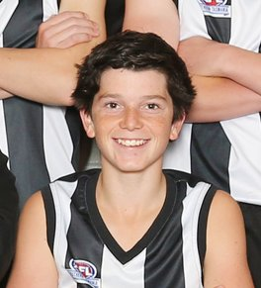
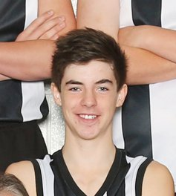
Coach Award
2013 Under 14
BEST AND FAIREST COUNT
Under 14
BEST & FAIREST
Dual Runners Up
Harrison Gunther
Ryan Sproule

Slide 57
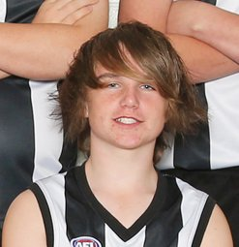
Coach Award
2013 Under 14
BEST AND FAIREST COUNT
Under 14
BEST & FAIREST
Winner
Brodie Rowbottom

Slide 58
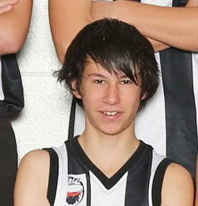
Coach Award
2013 Under 14
BEST AND FAIREST COUNT
MOST CONSISTENT
Joshua Peters

Slide 59
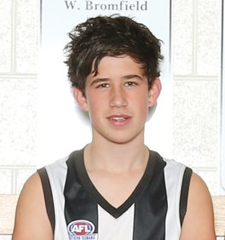
Coach Award
2013 Under 14
BEST AND FAIREST COUNT
MOST IMPROVED
Daniel Warwarek

Slide 60
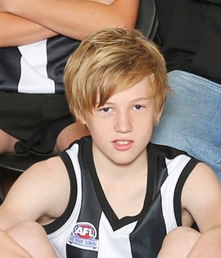
Coach Award
2013 Under 14
BEST AND FAIREST COUNT
COACHES AWARD
Lucas Henderson

Slide 61
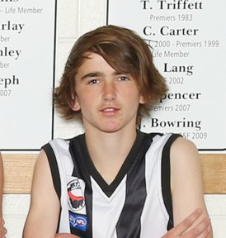
Coach Award
2013 Under 14
Stringline DataTech Services AWARD
Team player Award
Christopher Allen

Slide 62
Leaderboard 3
2013 Under 14
BEST AND FAIREST COUNT
LEADER BOARD
LEADERBOARD
1
Brodie Rowbottom (124)
6
Kobey Phillips (37)
2
Harrison Gunther (91)
7
Cameron Goodsell (29)
2
Ryan Sproule (91)
8
Lucas Henderson (27)
LEADERBOARD
3
Joshua Peters (61)
9
George Bickers (25)
4
Braydon Patterson (55)
10
Callum Stevens (21)
5
Aaron Brennan (38)
11
Adam Roberts (20)

